Slide 1
Build & Train a Feedforward Neural Network
Week 6 - Day 3

Slide 2
Recap – What We've Learned So Far
Neural networks: structure, layers, perceptrons
Activations, loss, backpropagation
PyTorch framework basics
GPU acceleration

Slide 3
Dataset Overview
Choose a dataset that’s:
Simple
Tabular or image-based
Not too large
Example Options:
Iris (tabular, 3-class classification)
MNIST (images, 10-class classification)
Wine Quality (regression)

Slide 4

Data Preprocessing
Load data
Encode labels (e.g., using LabelEncoder)
Normalize features (StandardScaler)
Split into training and test sets

Slide 5
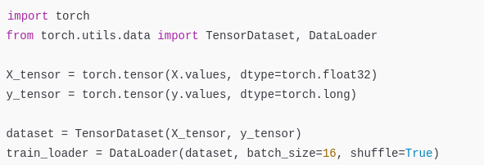
Convert to PyTorch Tensors
Why DataLoader?
Efficient batching
Shuffling
Easy iteration during training

Slide 6
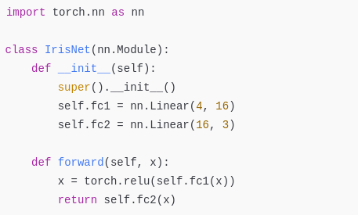
Define Model Architecture
Structure:
Input: 4 features
Hidden: 16 neurons, ReLU
Output: 3 classes

Slide 7
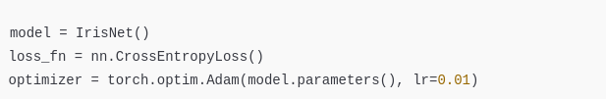
Set Up Loss & Optimizer
Cross Entropy Loss for multi-class classification
Adam optimizer is great for beginners

Slide 8
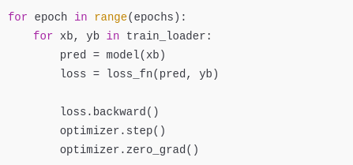
Training Loop (Forward + Backward)
loss.backward(): compute gradients
optimizer.step(): update weights
zero_grad(): clear previous gradients

Slide 9
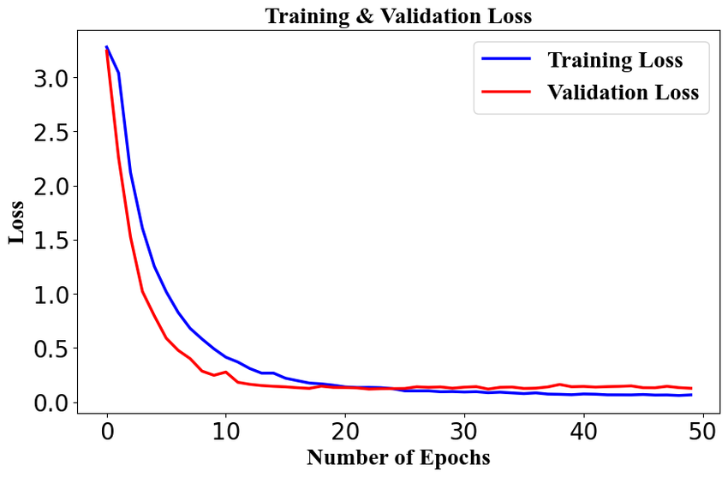

Monitoring the Loss

Slide 10
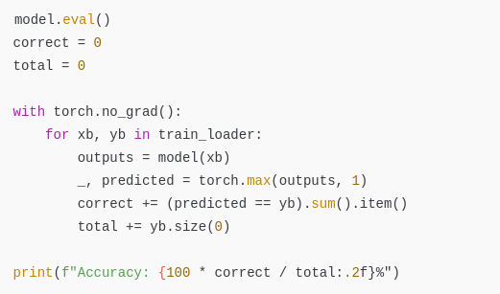
Evaluating Model Accuracy

Slide 11

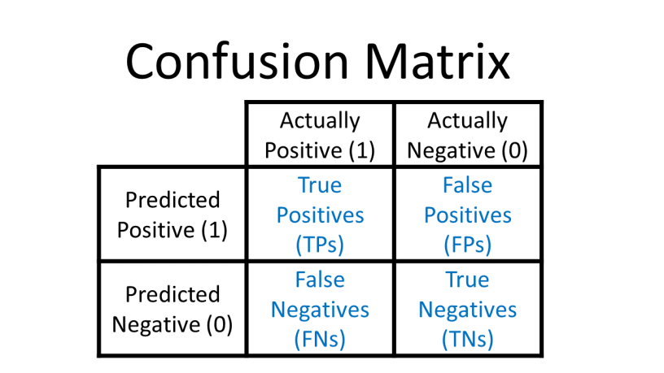
Confusion Matrix

Slide 12
Experiment – Tweak Your Model
Try:
More layers (add fc3)
Different activation (e.g., nn.Tanh)
Learning rate change
Batch size tuning
Add dropout layer

Slide 13
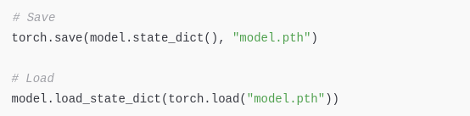
Saving & Loading Models

